Slide 1

Prepared by Team KK
Group Project
Snake Game AI: Deep Q-Learning vs PPO
05 MAY, 2025

Slide 2


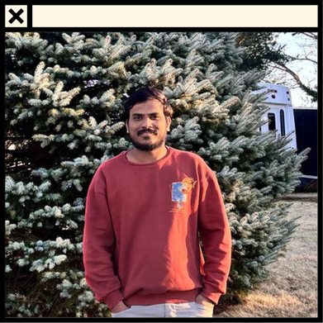
Team Members
Ganesh Munagala
Akash Vemula
Naveen Reddy
Design Engineer
ML Developer
Data Engineer

Slide 3
Introduction
Our project aims to develop and compare reinforcement learning strategies to train an AI agent to play the Snake game efficiently. We recognize the significance of model-free learning techniques in dynamic environments and intend to implement and analyze both Deep Q-Network (DQN) and Proximal Policy Optimization (PPO) algorithms. Our goal is to evaluate their performance, learning efficiency, and stability, while gaining insights into their effectiveness in mastering complex decision-making tasks.

Slide 4



Research Questions
Whether RL agents can independently develop competent survival strategies through interaction-based learning without explicit rules or supervision ?
How value-based (DQN) and policy-based (PPO) learning approaches compare in terms of convergence speed, stability, and robustness ?
Whether trained agents can maintain performance consistency even as the game progresses into novel or less frequently seen scenarios (i.e., generalization) ?

Slide 5

Project Objective
Our Main Objectives of the project are,
Train a reinforcement learning agent to master the Snake game using reward-based learning.
Implement and compare two model-free algorithms — Deep Q-Network (DQN) and Proximal Policy Optimization (PPO) — within the same game environment.
Evaluate and visualize learning efficiency through training outcomes, score progression, and reward trends.

Slide 6

Tools & Technologies
Python:
NumPy, Pandas and Matplotlib: :
Used as the primary programming language to build and integrate all components of the project — including the game environment, training loops, agent logic, and evaluation scripts.
NumPy supported efficient numeric computations and array transformations. Pandas was used for logging and managing training data, while Matplotlib helped visualize the agents’ performance trends
PyTorch and PyGame:
GitHub for version control:
PyTorch was used to design, train, and evaluate the reinforcement learning models (DQN and PPO). Pygame provided the interactive game environment for training and testing the Snake agent.
GitHub hosted the full project codebase, facilitated collaboration, and maintained version history throughout the implementation and testing phases.

Slide 7

Game Overview
Score: 099
How To Play ???.....
The Snake moves continuously in one of four directions: up, down, left, or right.
The objective is to eat food items that appear randomly on the grid.
Each food item increases the snake’s length and adds to the score.
Only one piece of food is present on the grid at a time.
The game ends if the snake collides with a wall or its own body.
The player (or agent) must learn to survive as long as possible and maximize score through movement decisions.
Game Overview

Slide 8
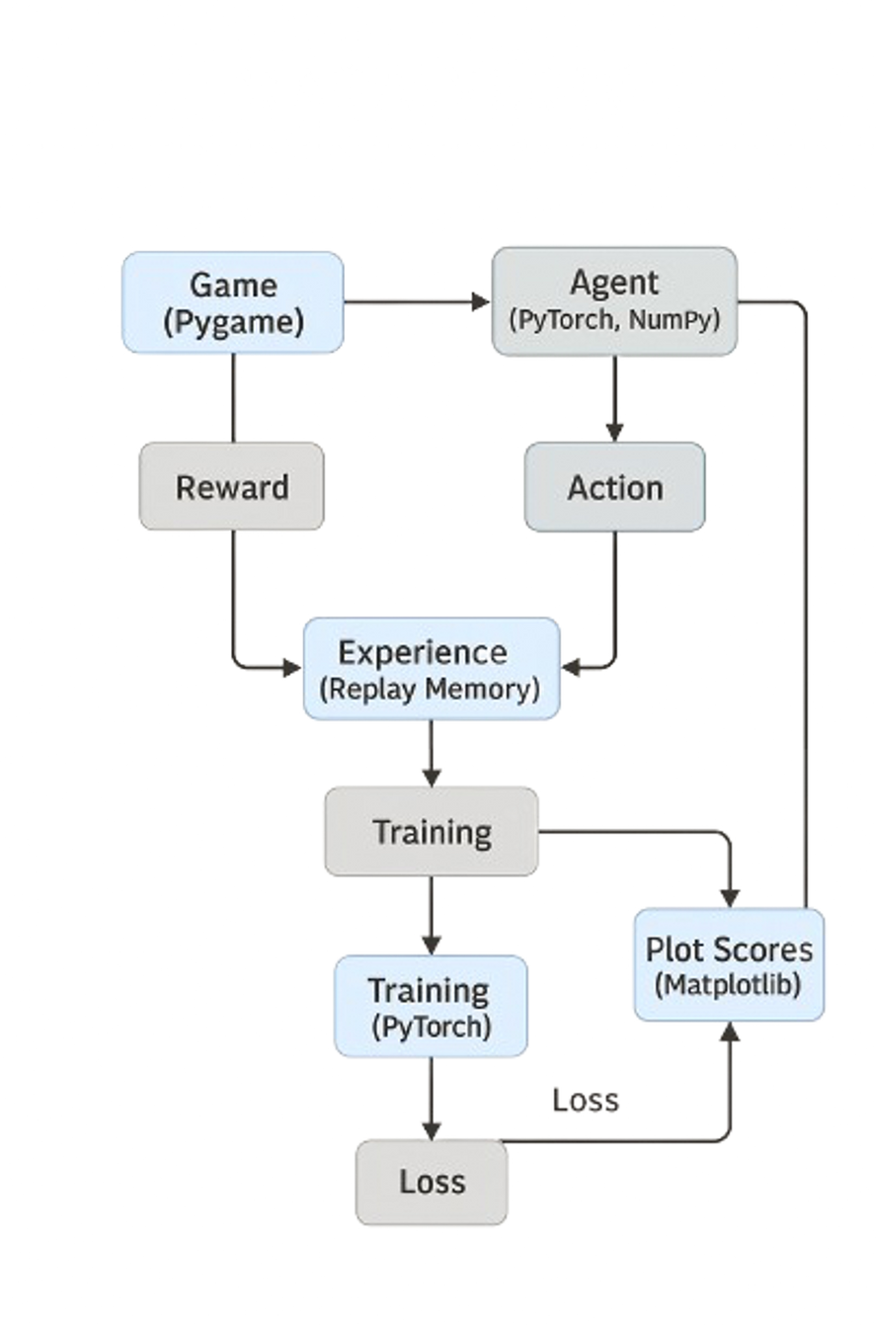
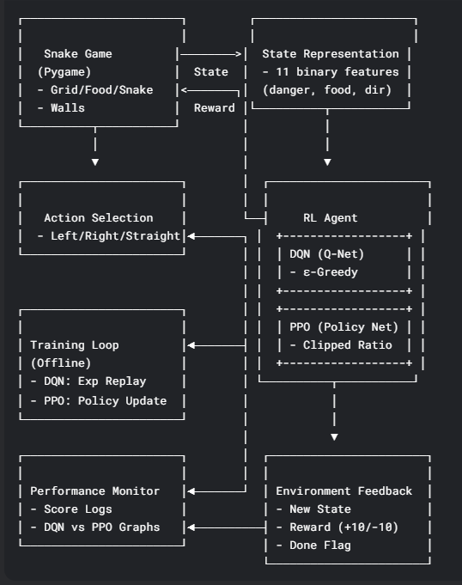
Architecture Diagram :
Game Data Flow :

Slide 9
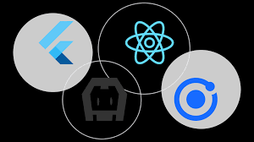
Algorithms:
DQN Agent (Deep Q-Network) :
Value-based reinforcement learning method.
Uses a neural network to estimate Q-values.
Trains via experience replay and epsilon-greedy policy.
State Input: 11 binary features (danger, direction, food position)
Neural Network: Predicts Q-values for actions [Straight, Left, Right]
Action Policy: ε-greedy — explore or select best Q-value
Training: Experience Replay from memory buffer
Loss = MSE between predicted and target Q-values
Objective: Maximize expected reward through learned Q-values
Logs: Score & reward tracked in dqn_training_log.csv
DQN(Deep Q-Network)

Slide 10
Algorithms:
PPO Agent (Proximal Policy Optimization) :
Policy-based reinforcement learning method.
Uses stochastic policy and clipped loss function.
Optimizes policy after each episode with stability.
State Input: 11 binary features (danger, direction, food)
Policy Network: Outputs action probabilities using softmax
Action Selection: Samples from distribution; stores log-probs
Training (per episode):
Computes returns and advantages
Uses clipped surrogate loss to ensure stable policy updates
Objective: Maximize expected rewards while limiting large policy shifts
Logs: Episode rewards tracked in ppo_training_log.csv
PPO (Proximal Policy Optimization)

Slide 11
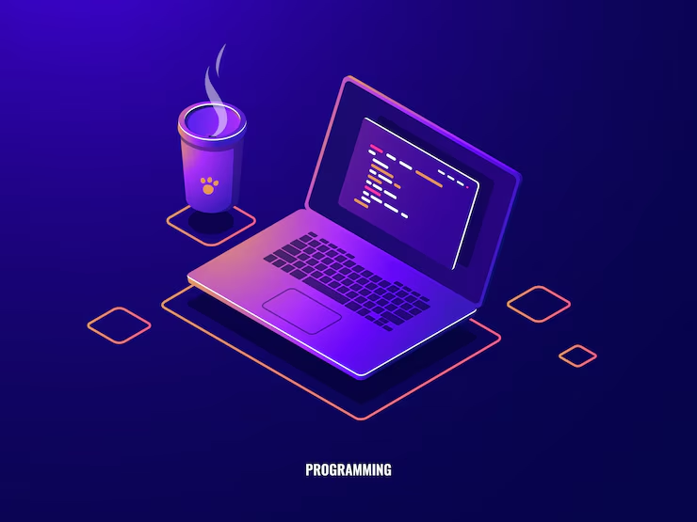
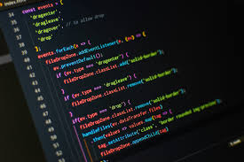
Code Explanation & Execution :
Explanation
Execution

Slide 12
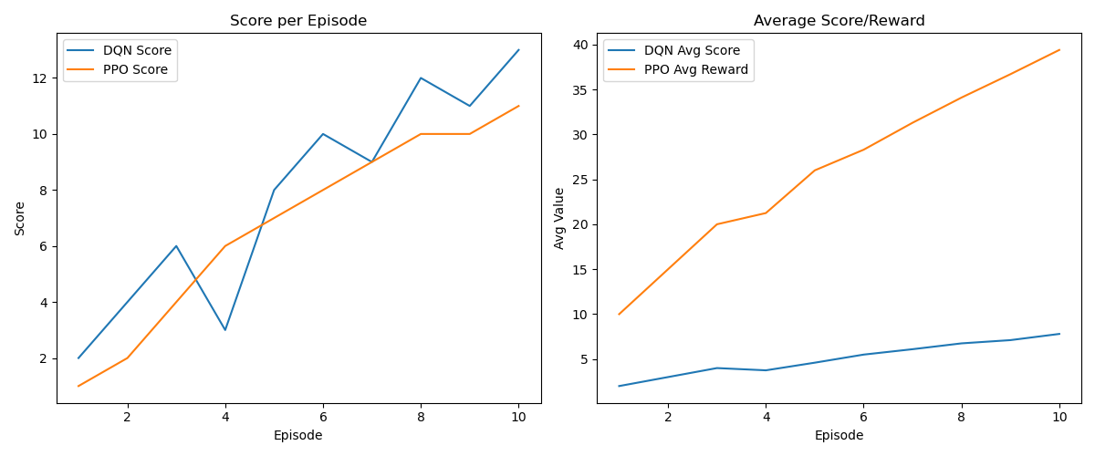
Evaluation Metrics :
Learning speed (sample complexity)
Score per episode
Average reward per episode
Stability and convergence over time

Slide 13
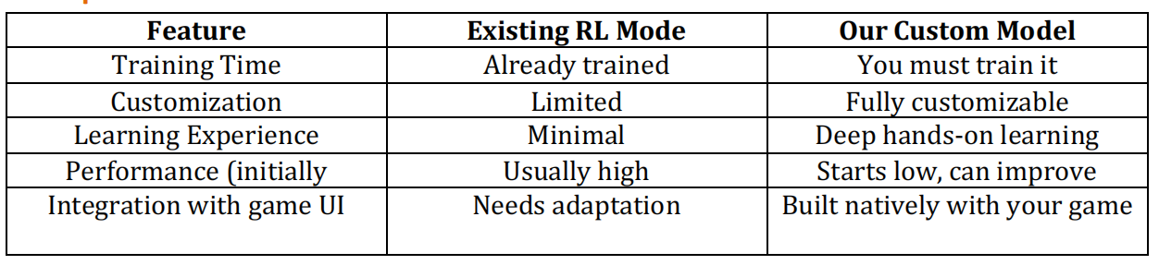
Comparison & Insights
DQN learns faster initially with sharper performance spikes.
PPO shows smoother, more stable learning.
Both models reach competitive gameplay performance.
When to use which?
Use an existing model if:
If you want a strong Snake AI quickly for demonstration or benchmarking.
Use our own model if:
If You want to learn RL, experiment with game mechanics, or develop a custom AI that fits your unique Snake game variant.

Slide 14
Challenges & Adjustments :
- PPO agent integration required custom training loop and log probability tracking
- Snake game input format needed adaptation between agents
- Evaluation mode required saving and loading separate model architectures
Achievements :
- Fully functional Snake environment
- DQN and PPO agents implemented and trained
- Training logs and score tracking via CSV
- Evaluation script to replay models
- Comparison graphs generated using matplotlib

Slide 15

Outcomes :
Key Outcomes :
DQN demonstrated faster initial learning but with more fluctuation in performance.
PPO showed smoother, more stable learning over time due to its policy-based approach.
Both agents achieved competent gameplay, successfully learning to avoid collisions and maximize scores.
Training logs were collected and visualized to assess learning trends using metrics such as:
Score per episode
Average reward
Sample complexity
Stability of policy updates
The project met all key objectives: environment setup, model training, performance logging, and evaluation.
Results were documented and visualized in reports, CSV logs, and plots for comprehensive analysis

Slide 16
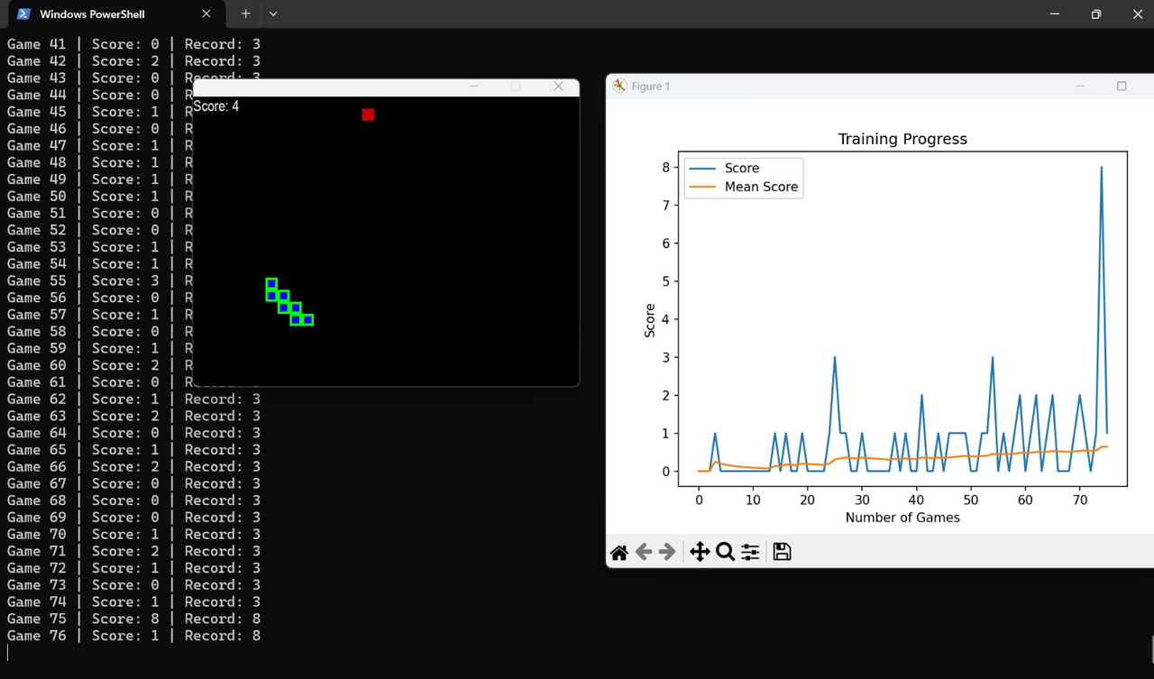
Sample Results :
For DQN Algorithm

Slide 17
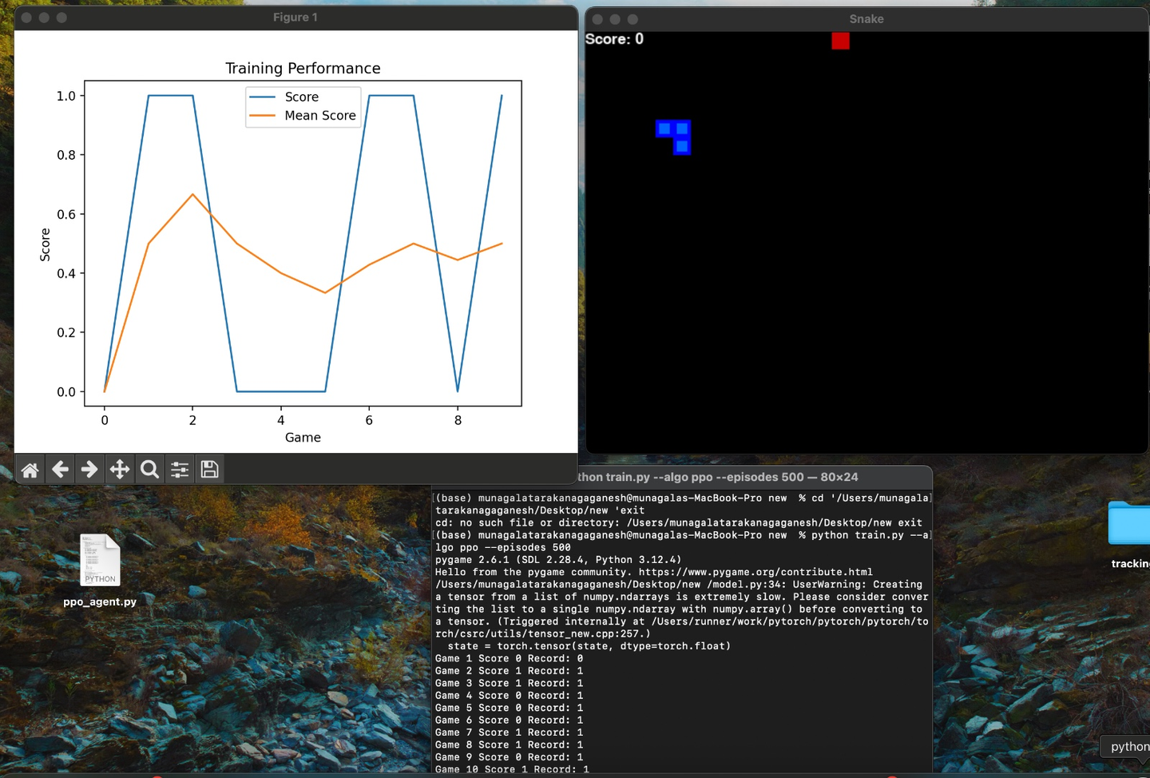
Sample Results :
For PPO Algorithm

Slide 18
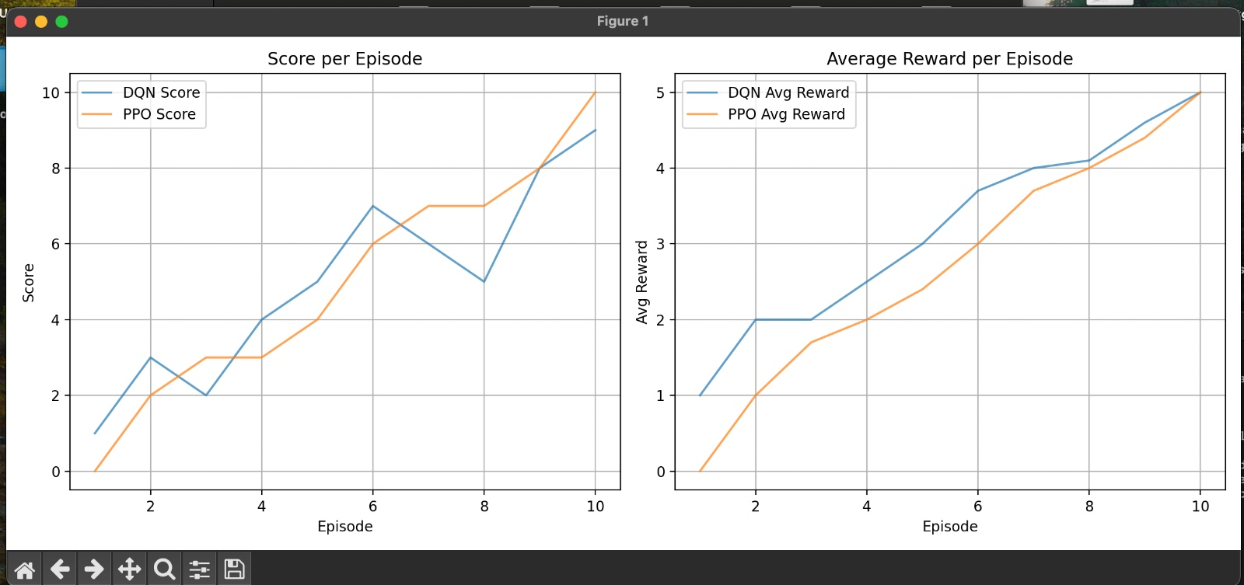
Sample Results :
Comparision btwn DQN & PPO Algorithms

Slide 19
Related Literature
1. Mnih et al. (2015), "Human-level control through deep reinforcement learning" -
https://www.nature.com/articles/nature14236
2. Schulman et al. (2017), "Proximal Policy Optimization Algorithms" -
https://arxiv.org/abs/1707.06347
3. Patrick Loeber's Snake AI with PyTorch & Pygame -
https://www.youtube.com/watch?v=L8ypSXwyBds

Slide 20
Conclusion
The project successfully met all objectives, including custom environment setup, agent training, performance logging, and evaluation. Deep Q-Network (DQN) exhibited faster initial learning but showed greater performance fluctuation, while Proximal Policy Optimization (PPO) provided smoother and more stable learning due to its policy-based nature. Both agents demonstrated competent gameplay by learning to avoid collisions and maximize rewards. Training logs were captured and visualized using metrics such as episode scores, average rewards, sample complexity, and policy stability. The comparative analysis, supported by CSV logs and plotted graphs, provided a comprehensive understanding of the learning dynamics and effectiveness of both reinforcement learning approaches.
GitHub Link: https://github.com/GaneshMunagala714/Snake_Game_AI/tree/main

Slide 21
Thank you

